Slide 1








Slide 2

Familiar Care is an animal healthcare app that has an encyclopedic guide to assist pet owners in taking care of the health of their pets. It provides feeding and seasonal care advice, rough symptom-based diagnoses through an AI chatbot. It also provides the user with addresses of closest vet clinics in case of emergencies and keeps track of in-depth pet health history (vaccines, visits, prescriptions) as well as providing text and video consultation with vets 24/7. The app is suitable for experienced and first-time pet owners alike, providing educational learning and care advice for different species of animals.

Slide 3

Some of the challenges that have been identified and tackled in this project are:
Lack of immediate medical help due to unavailability of vet clinics in certain areas mainly rural.
Improper caretaking of pets often resulting in major health risks.
Absence of proper medical records leading to missed vaccine shots, vet visits, etc.
Misdiagnosing or ignoring alarming symptoms or disregarding them as normal hormonal or seasonal habits.
No awareness of emergency measures that can be taken to help stabilize the pet until proper healthcare can be provided.

Slide 4

The Key features of our project are:
AI Symptom-based analysis: Immediate examination of the symptoms recorded by the user to provide a rough diagnosis and how to stabilize the pet until proper healthcare is provided.
Pet-Care Encyclopedia: Provides user with the DO’S and Don’ts for proper feeding practices, seasonal pet care for various domestic species.
Health Record Management: Maintain a record with each pet’s vaccination, prescriptions and medical background in an organized manner.
Vet Locator: Provides routes to nearby vet clinics on maps to the user.
External consultation support: Providing online text/video vet consultation if in-person vet access is limited.

Slide 5

Multi-species support: While many apps mainly focus on dogs and cats, Familiar Care expands the dataset to include a wide range of livestock and domestic animals which caters to the needs of diverse pet owning population.
Extensive pet Encyclopedia: This feature offers a comprehensive knowledge base on a pet’s meal requirements, seasonal habits, what practices to implement and avoid in taking care of your pet, providing insightful petkeeping guidance to first time pet owners.
Multiple Pet Profile Management: The application supports multiple pet profiles, so that users can track and maintain personal health records and care programs for each pet.

Slide 6

1.Frontend
React.js – Core UI framework
TypeScript – Type-safe development
Tailwind CSS – Utility-first CSS styling
React Router – Client-side routing
Axios – API communication
2.Backend
Node.js – JavaScript runtime
Express.js – RESTful API framework
JWT (JSON Web Token) – Secure authentication
3.Database
MongoDB – NoSQL database for storing users, pets, and health records
4.APIs & External Services
Google Maps API – Find and display nearby veterinary clinics
OpenStreetMap (optional) – Geocoding and fallback location services

Slide 7

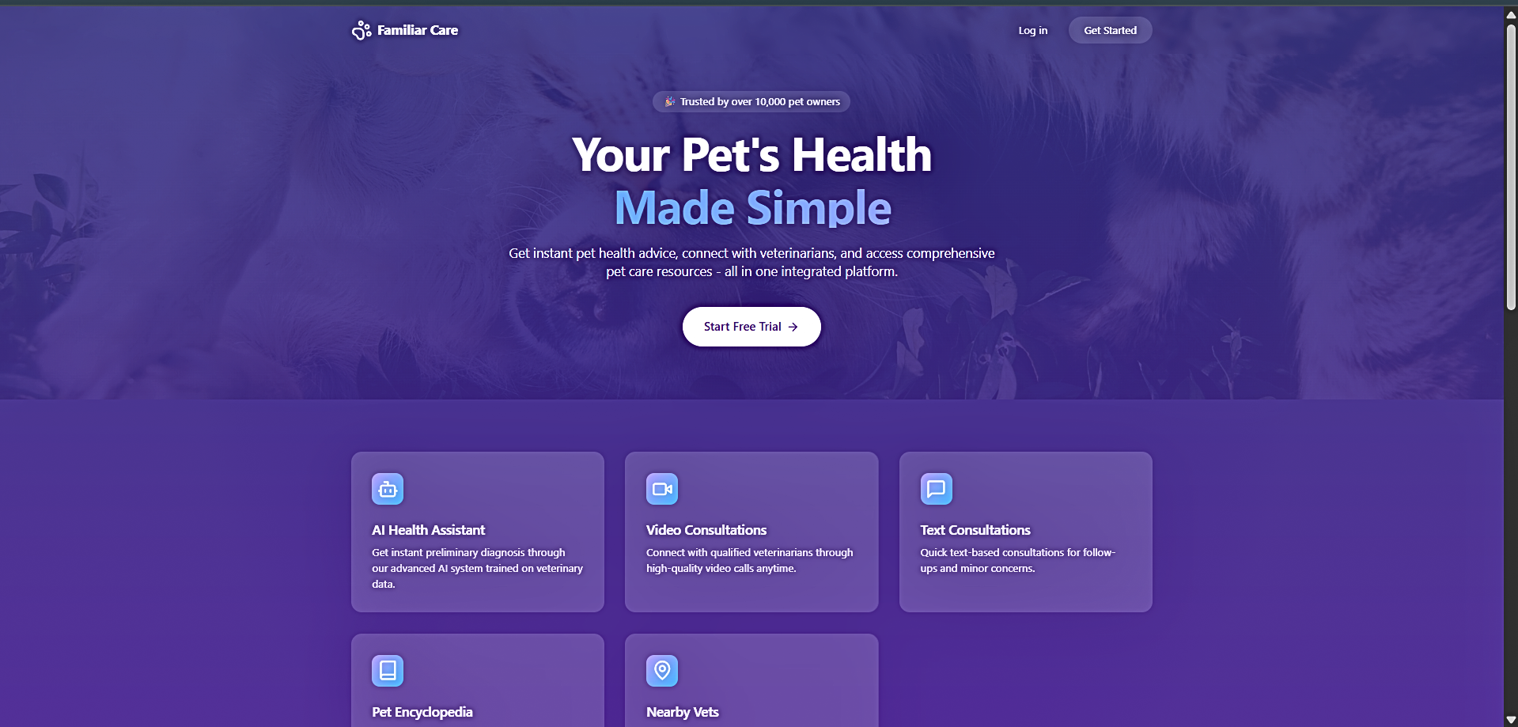
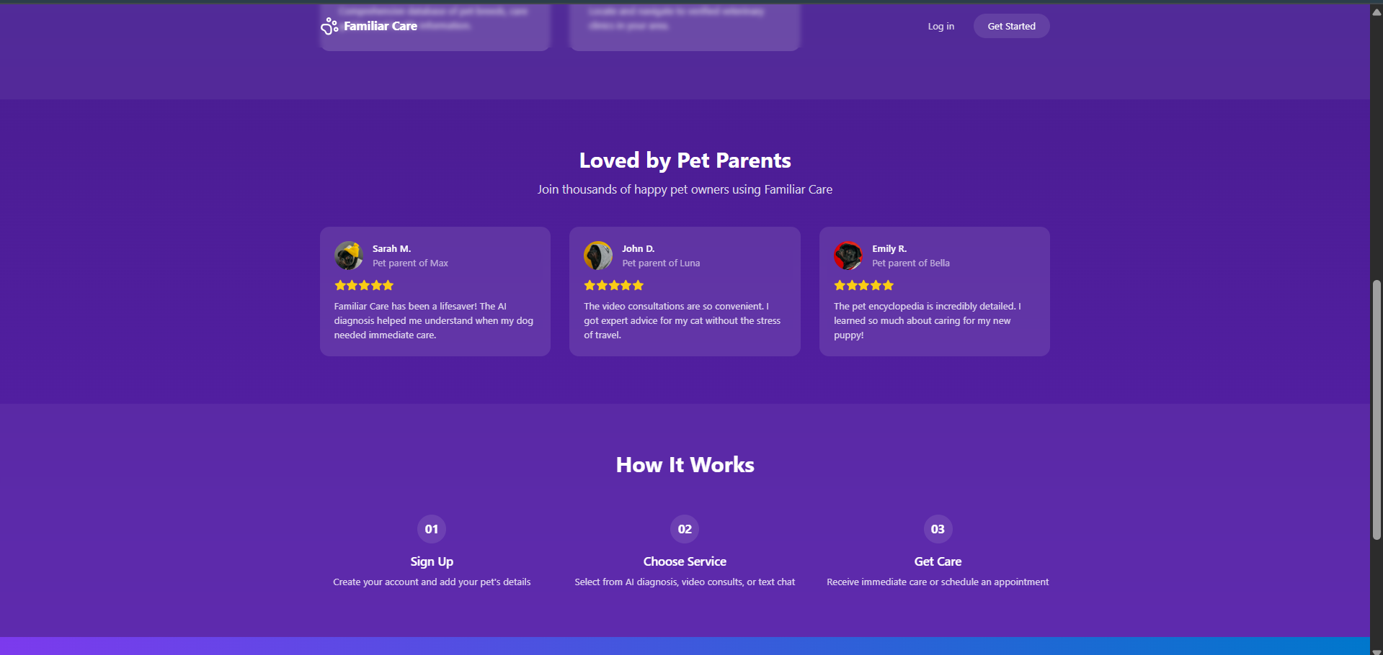
Home Screen

Slide 8
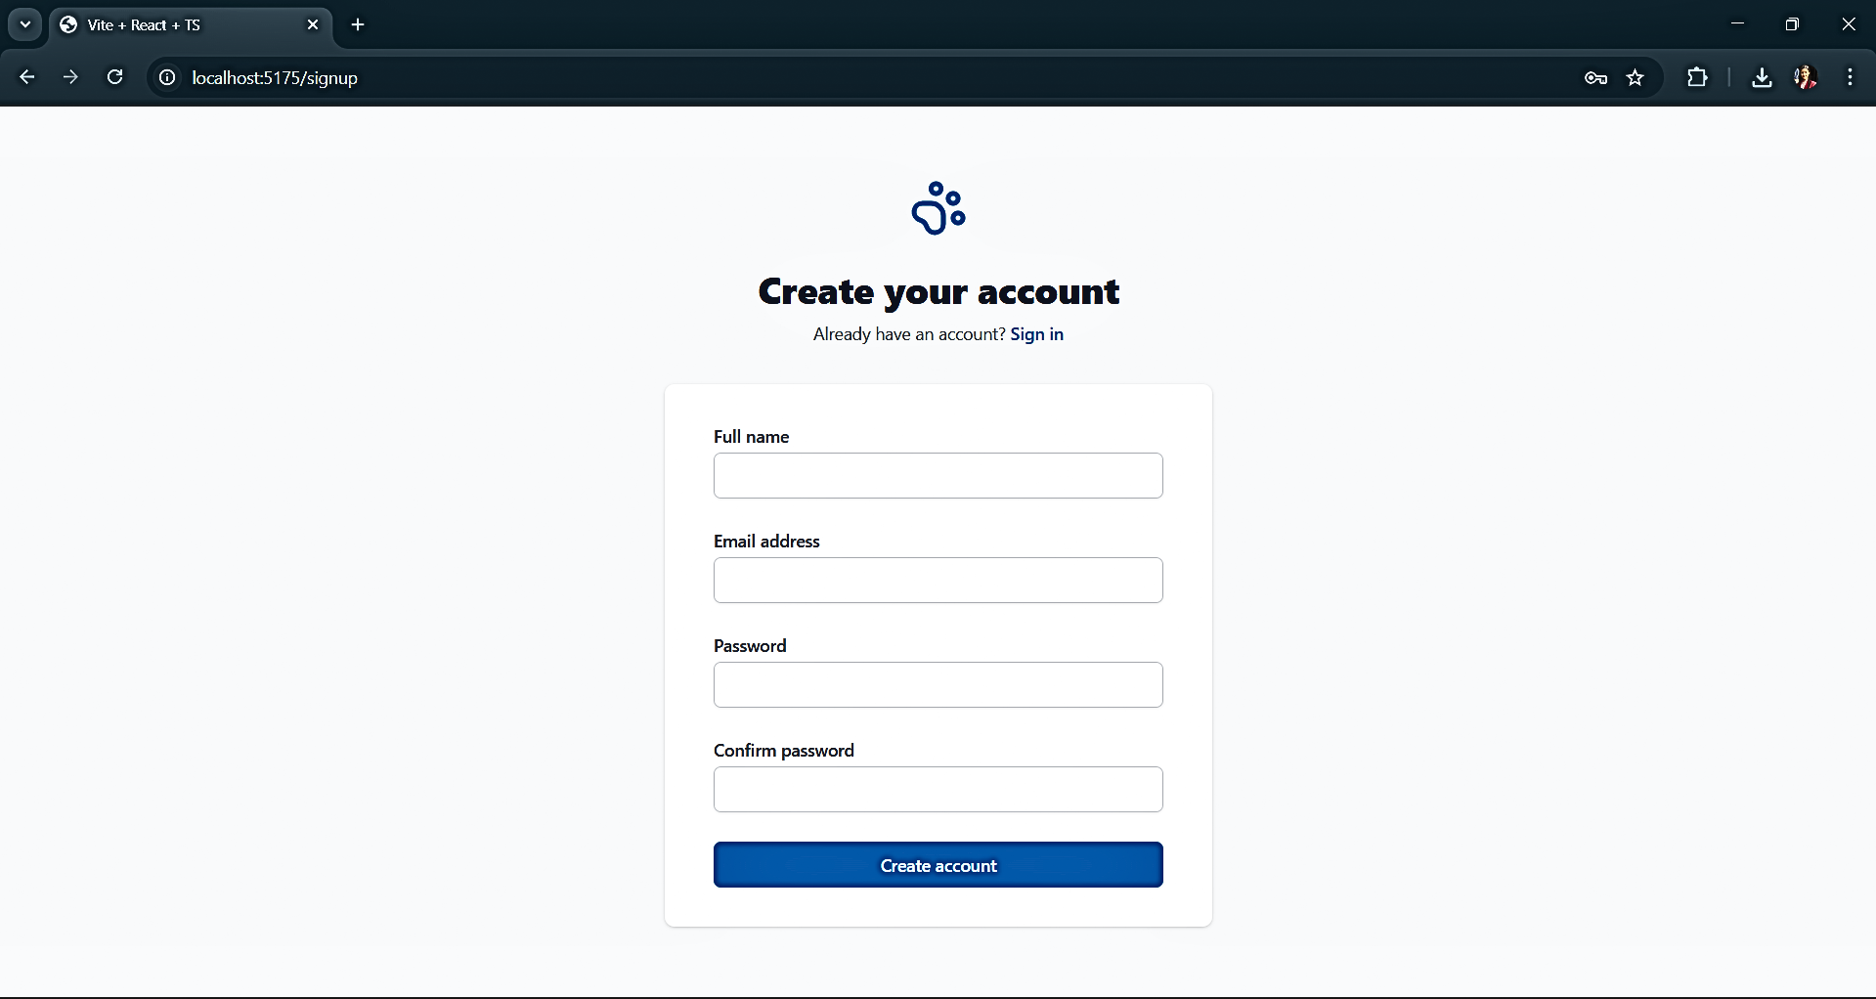
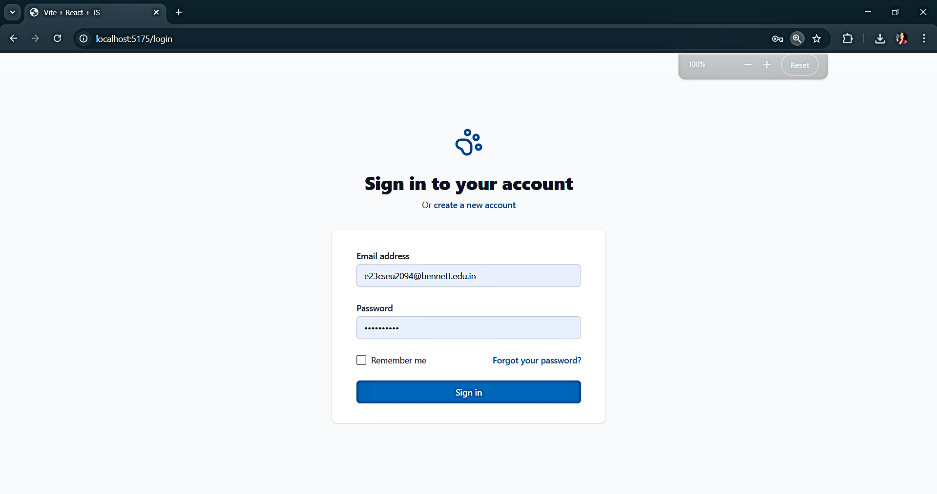
Secure sign up and sign in to allow secure user authentication

Slide 9
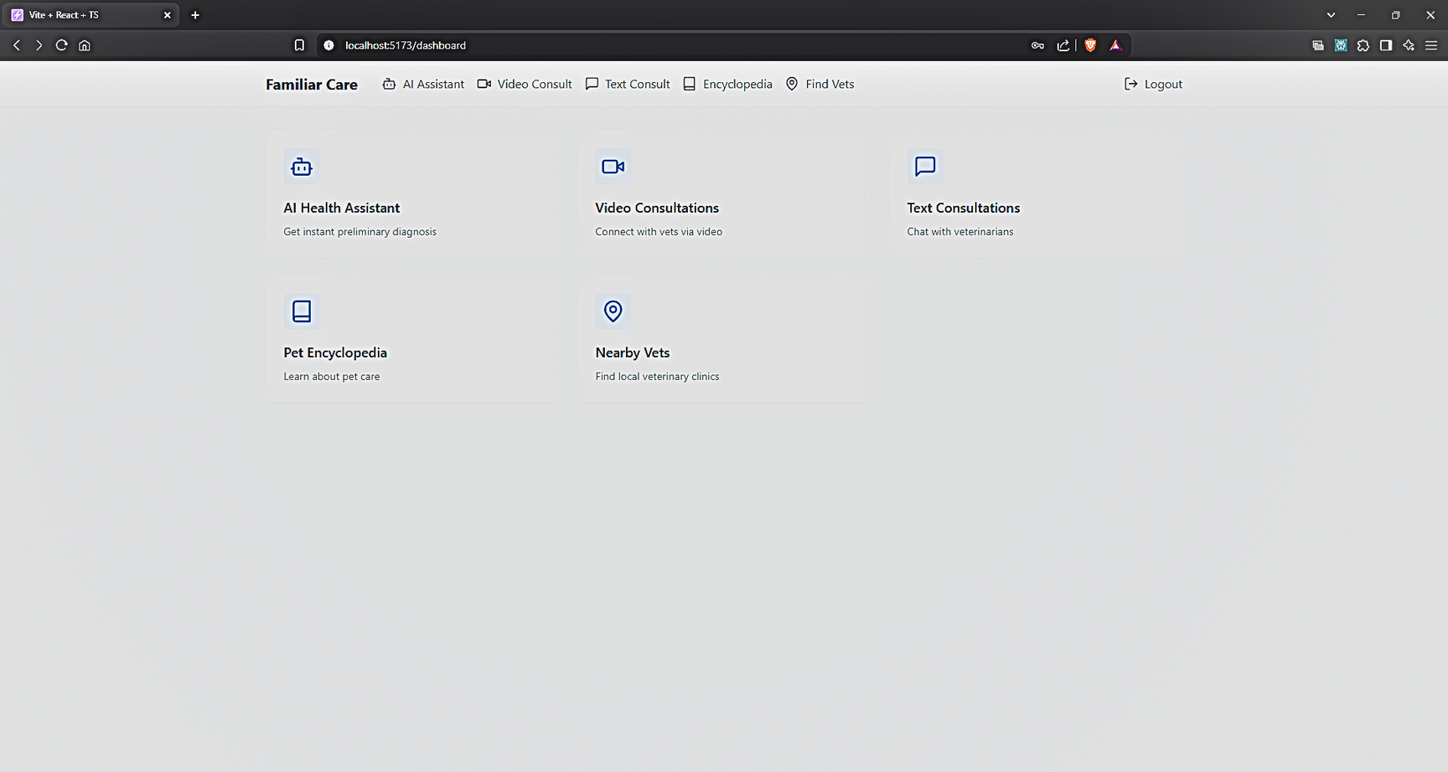
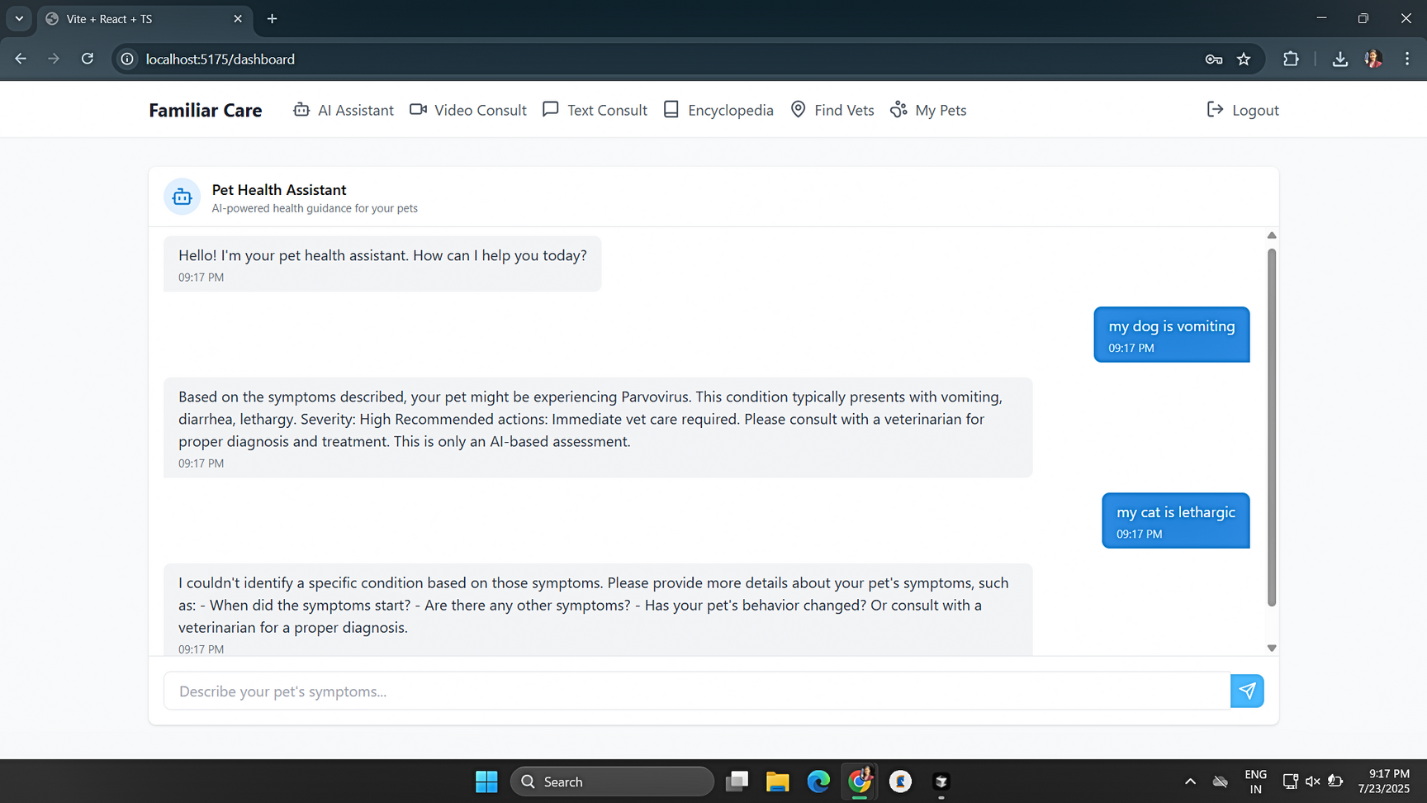
Menu Page providing a brief description of every feature
Ai Chatbot feature for providing rough symptom based diagnoses

Slide 10
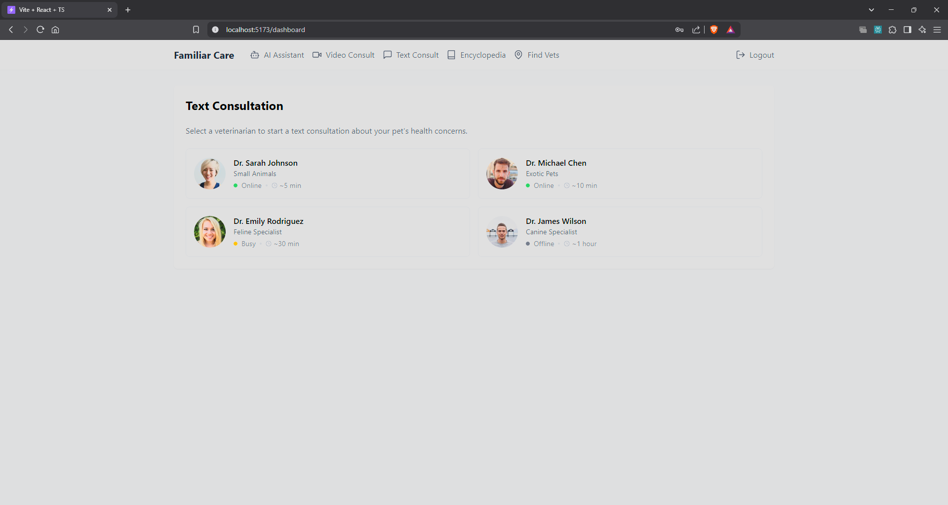
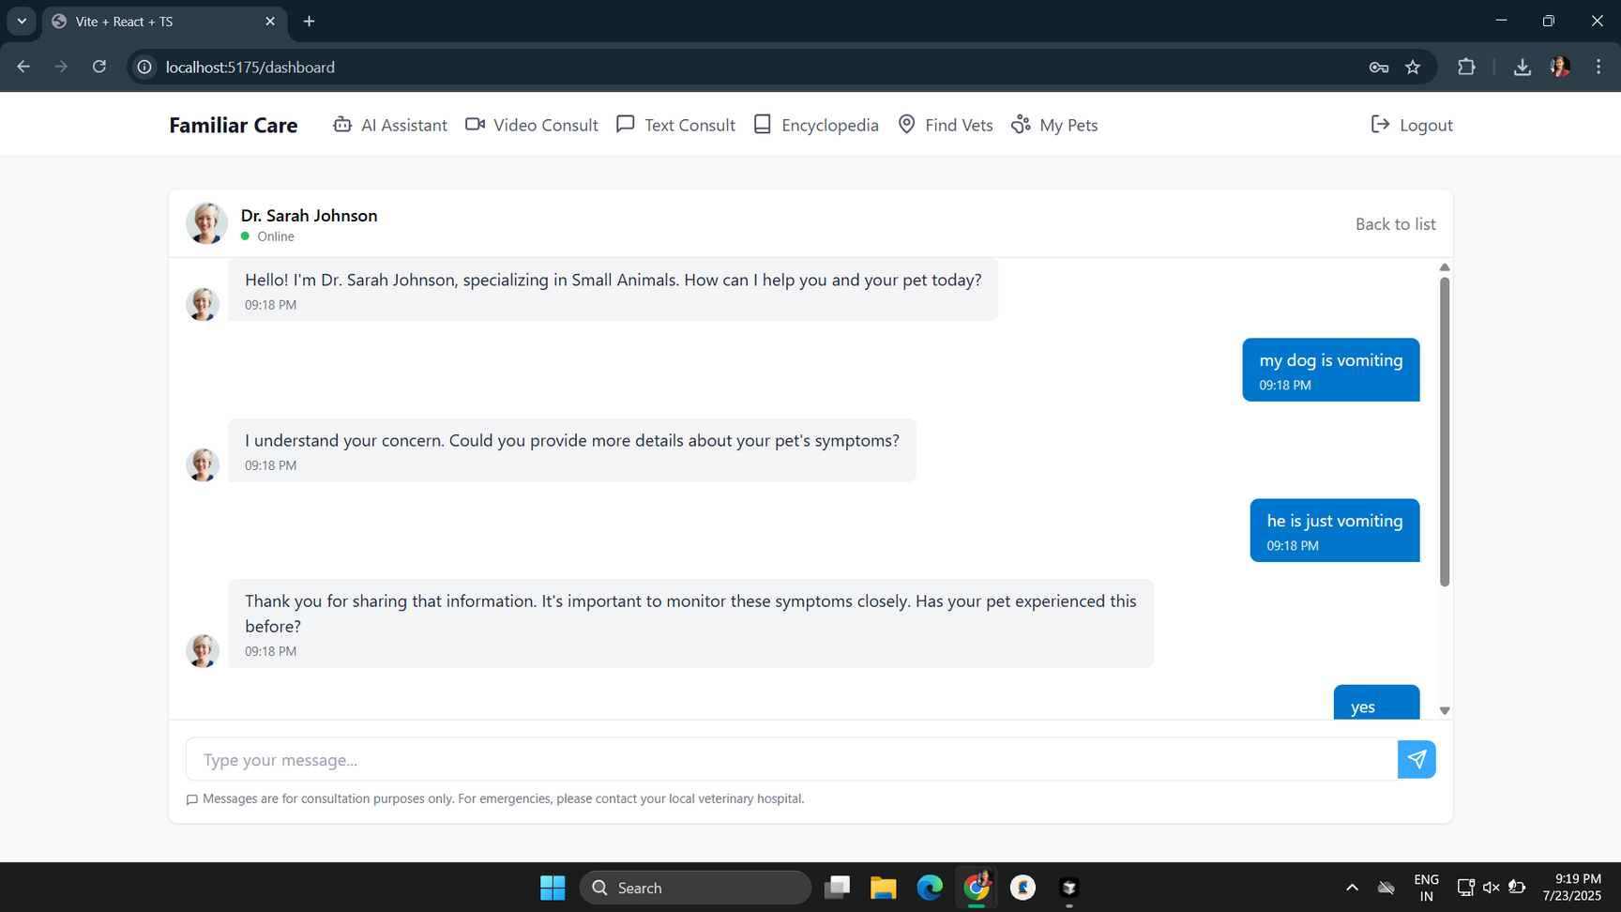
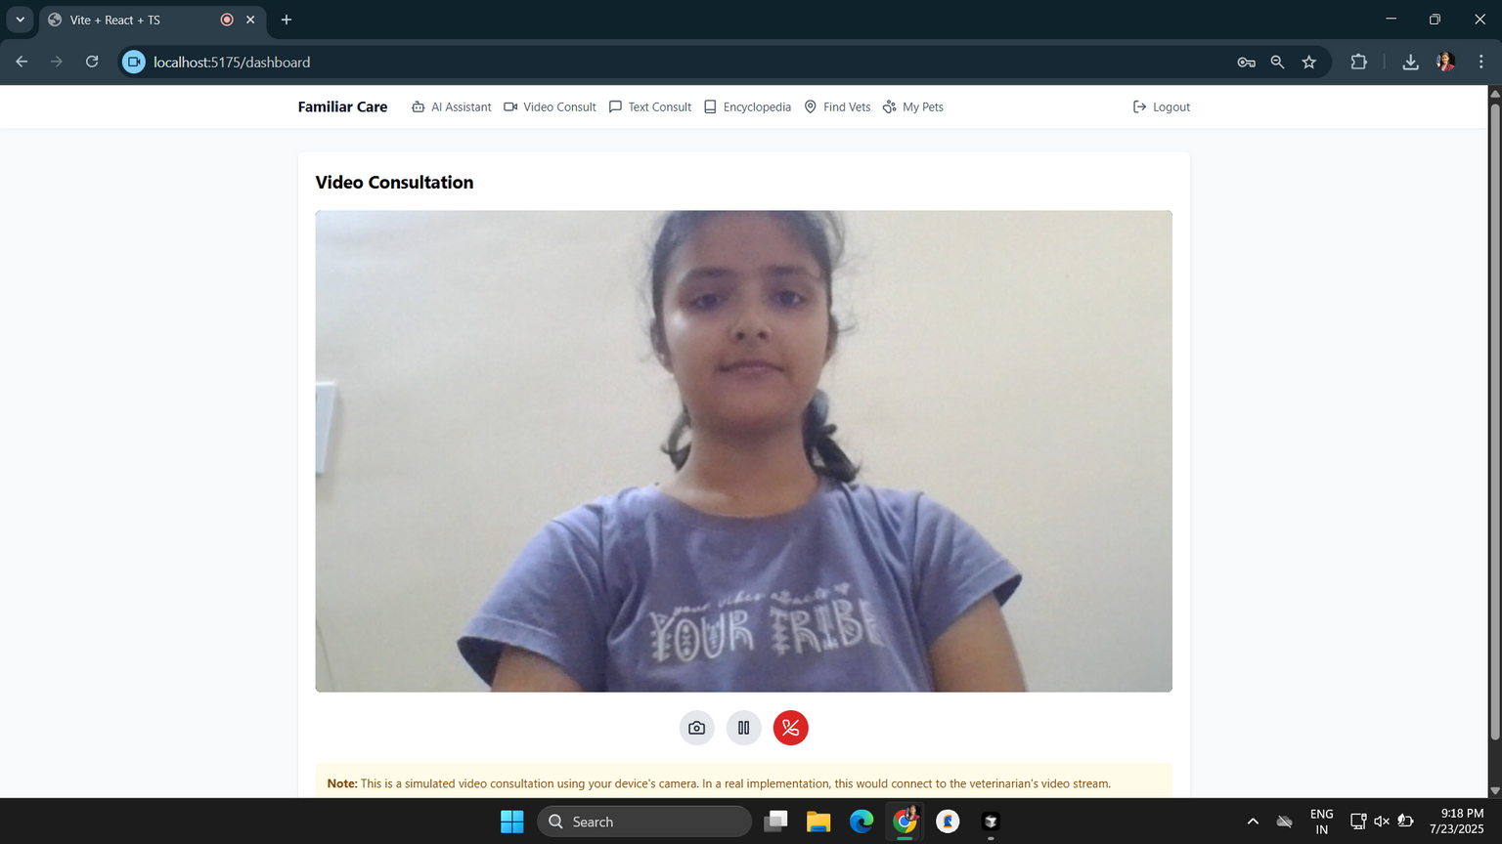
Real Time text and video-call Consultation with licensed expert vets

Slide 11
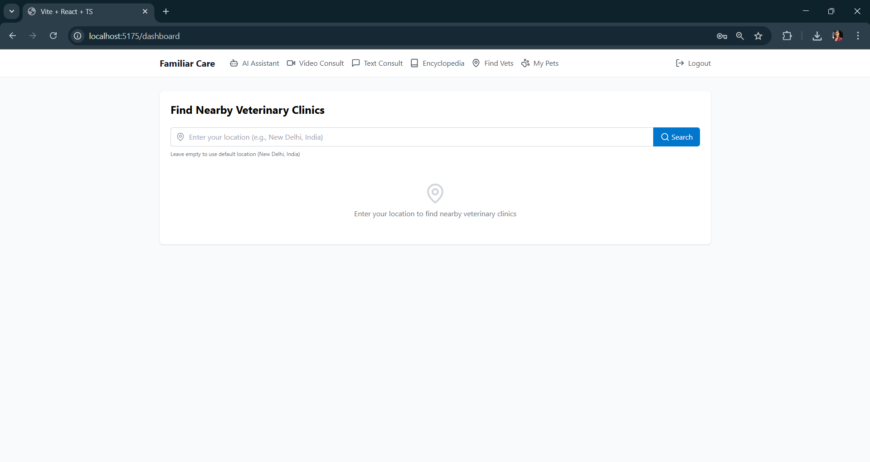
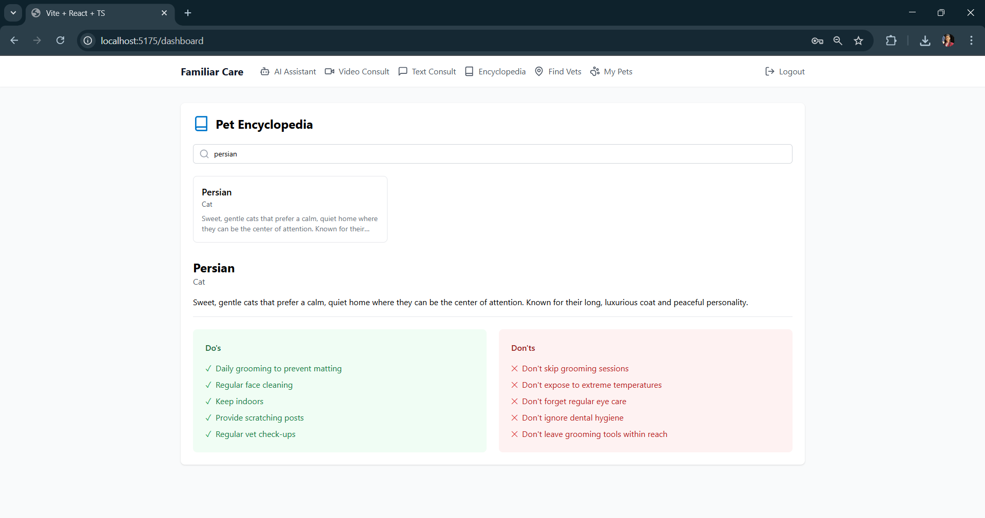
Vet Locator provides map with routes to near vet clinics allowing timely medical attention in emergency cases.
Pet Encyclopedia providing useful info on proper petkeeping.

Slide 12
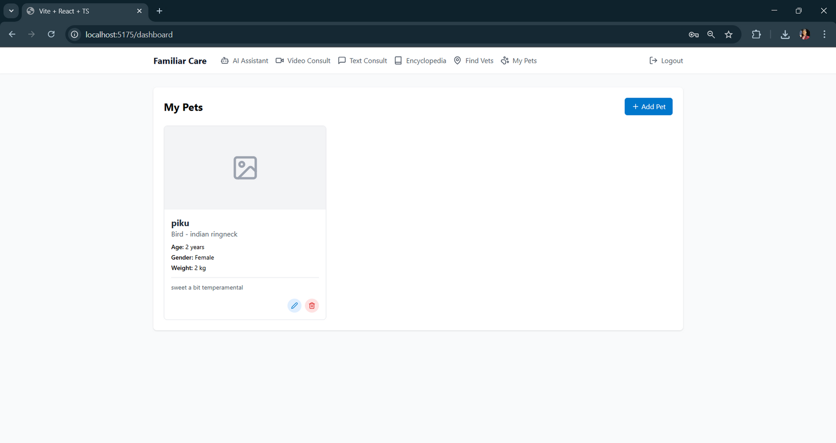
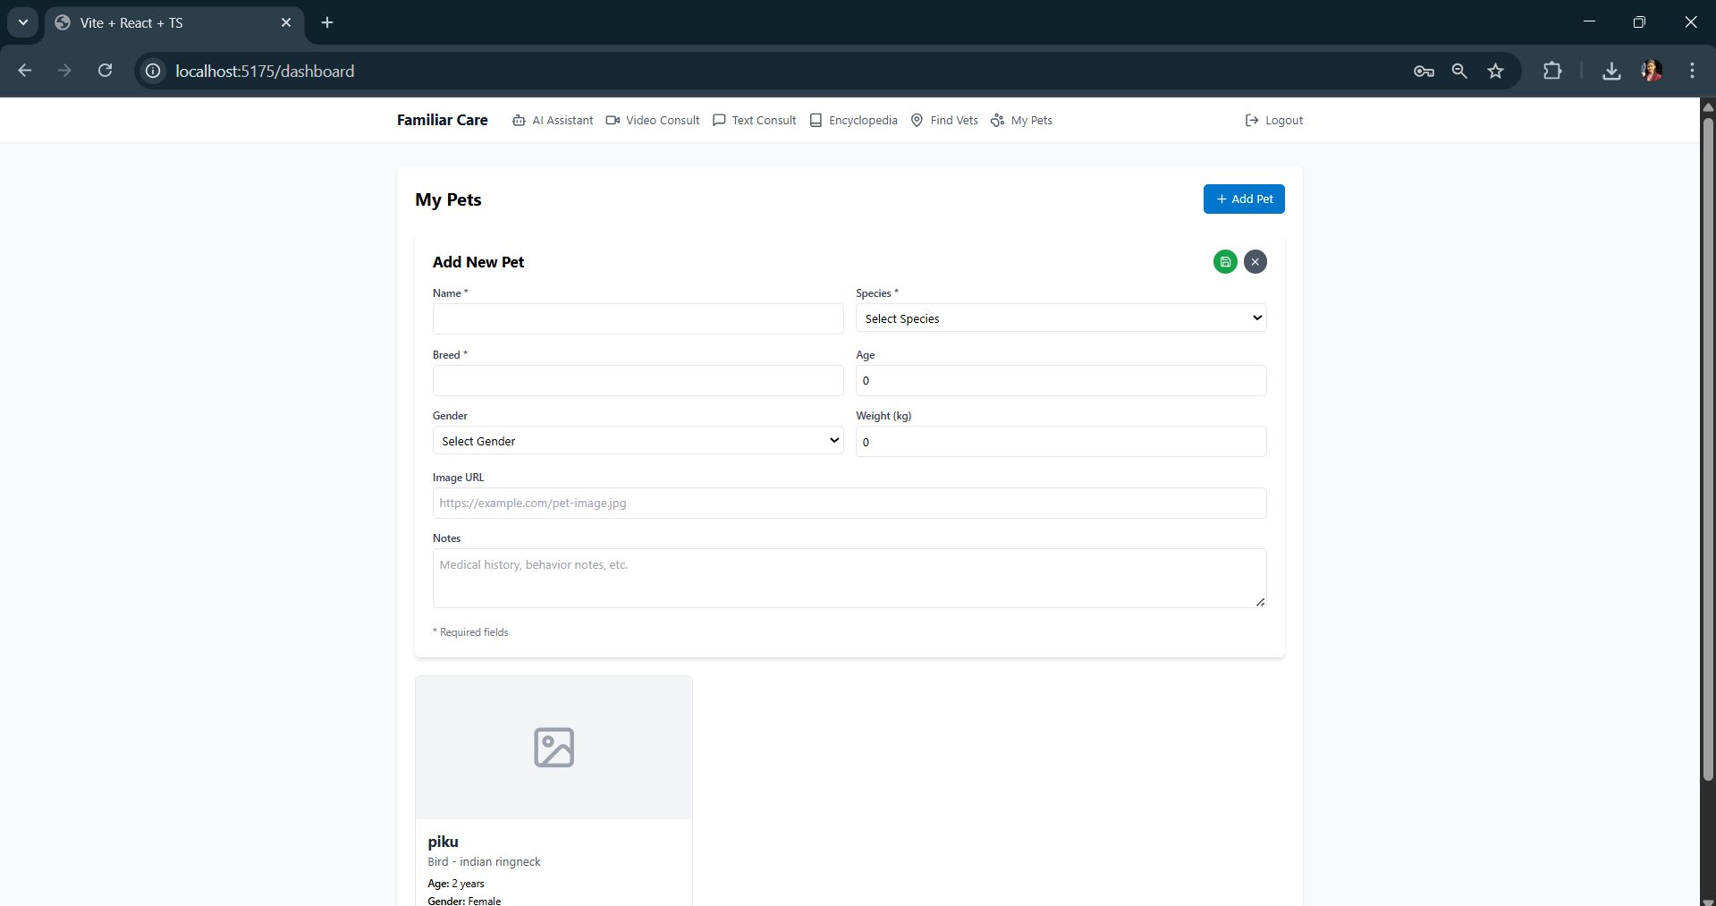
Pet Profile management allowing users to store important details regarding their pets.

Slide 13
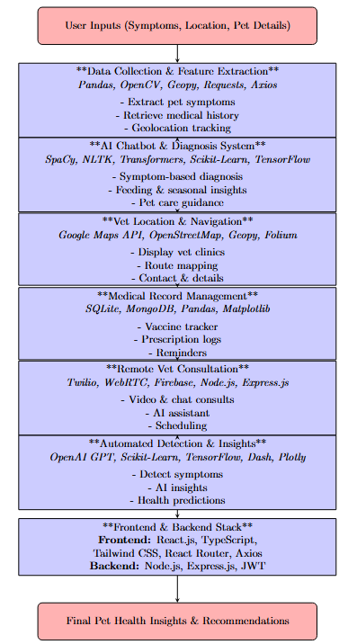


Slide 14

1. Adapts to India's PDPB (Personal Data Protection Bill): Familiar care is designed in accordance with India's Protection of Personal Data, ensuring that all individual and sensitive information including Pet Health Records and User Identities remains secure.
2.Ad-free experience: The application is also ad-free, which allows for an uninterrupted and trust-based user experience.
3.Informed consent is required: A consent form or pop-up is displayed during registration or boarding, and ensures that users agree on terms and privacy rules. This confirms that the app is legally obedient and morally transparent.
4.Clear Disclaimer: The AI symptom-analysis chatbot cannot be used as a substitute for medical consultation as it is only providing a rough diagnosis based on the user inputted symptoms.
5.Liscenced Medical staff: The veterinarians who are employed for consultations have an approved license from the Veterinary Council of India (VCI) under the Indian Veterinary Council Act, 1984.
6. All features of the application are in accordance with the Animal Welfare board of India.

Slide 15

Pet Owners(Urban & semi-urban sector): useful for first-time owners and busy professionals who need fast and reliable pet health advice.
Livestock Owners (Rural & Agricultural Sector): Farmers with livestock in rural areas often face vet shortages or distance challenges and need early disease detection and immediate guidance.
NGOs & Animal Welfare Groups: Organizations involved in animal rescue, stray care, rehab.

Slide 16

1.Veterinary Telemedicine: A Literature Review by Lori Massin Teller & Heather K. Moberly: “Supports the use of teleconsultations and mobile health (mHealth) devices for monitoring animal health and Emphasizes the importance of understanding when and how to utilize telemedicine effectively in veterinary practice.”
2.Small Animal General Practice Veterinarians' Use and Perceptions of Telemedicine, JAVMA, 2021: "Use of video-based telemedicine substantially increased among respondents during the COVID-19 pandemic, and most (86/130 [66.2%]) reported little to no difficulty in adopting videoconferencing. Respondents also reported that telemedicine took less time (61/135 [45.2%]) and resulted in less financial compensation (103/135 [76.3%]) than in-person consultation."
3.Enhancing Relationships between Veterinarians and pet Owners with AI by Massimiliano Melis: “
The veterinary sector has thus far been poorly supported by digital innovation. The profession has
Largely been taught with conventional methods, but with the rise of AI, another powerful tool is now
available to veterinarians, and many professionals and their faculties are starting to embrace this
new technology."

Slide 17

1.Multilingual support: To increase access across various areas, Familiar care is planned to include multilingual Feature. This will allow users of different linguistic backgrounds to interact in their preferred language.
2. Extended dataset to include multiple domestic species: The datasets of the application can be updated to include more domestic and livestock species.
3. Reminder System for Vet Visit: While the project is currently tracking medical history, a more advanced user-set reminder feature can be added.
4. Better mapping facilities with external conditions: The mapping function can be expanded to show the nearby veterinary clinics, as well as include external factors such as traffic, road work, weather conditions and estimated travel time in estimating routes.
5.We can also integrate a voice assistance feature to enable specially-abled users to navigate through the app with ease.
6. We can also introduce the feature of appointment booking where the user can also book appointments with their preferred vet choice and avoid the hassle of trying to set medical appointments manually.

Slide 18

Familiar Care stands out in the field of animal healthcare by combining AI-driven diagnostics, real-time consultations, and comprehensive pet management tools in a single, user-friendly app. It is contributing to the progress in field of animal healthcare by helping pet owners act promptly, maintain medical records, and access nearby vets easily. Familiar Care improves preventive and emergency animal care. It benefits society by promoting responsible pet ownership, reducing untreated pet illness and supporting veterinarians with better informed users-ultimately resulting in healthier pets and more compassionate communities.
Familiar care is not merely an instrument. It’s your pet’s silent guardian - to observe their well-being, to remind you what matters, and when things get bewildering, leading you with gentle confidence.

Slide 19








Slide 20






